Slide 1



Spotify & Youtube Songs Statistics FRANGI Francesco Frigato, Andrea Felline, Gianluca Antolini
Master’s Degree in Computer Engeneering
Database 2 – Group Project - A.Y. 2023/23

Slide 2
TOPIC
Spotify Songs
STREAMS, MUSIC INFO, ARTISTS, ALBUMS, PLAYLISTS,
…
Youtube Videos
VIEWS, LIKES, COMMENTS, CHANNELS,
…

Slide 3
SLIDE PROSSIME IN ORDINE: -DATASETS -SCHEMA ONTOLOGY -CARICAMENTO DATI: PROBLEMI TROVATI, SCELTE FATTE ECC… -QUERY: 1 x slide (NON TUTTE LE QUERY, DECIDERE QUALI TENERE) + VEDERE SE FARE GRAFICI SU QUALCUNA INVECE DELLO SCREENSHOT

Slide 4
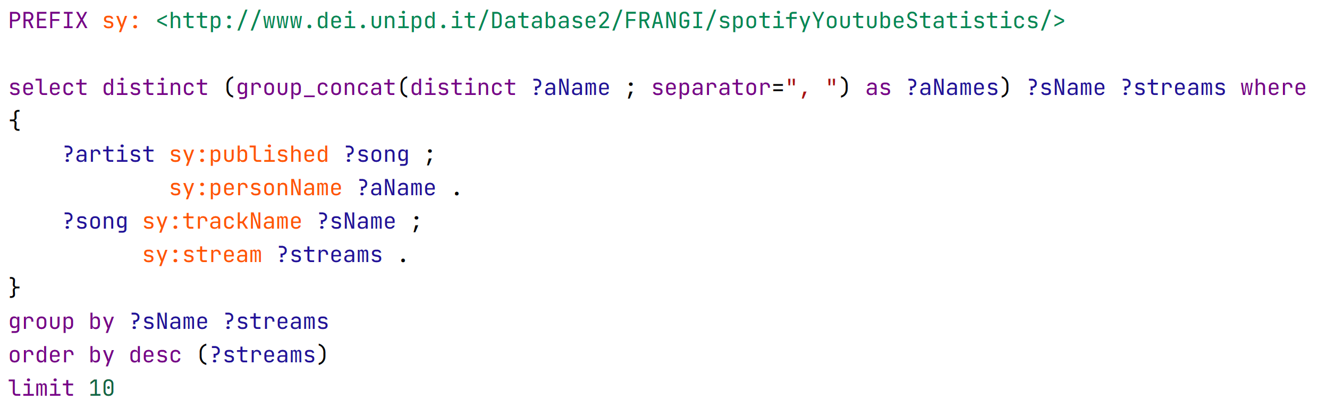
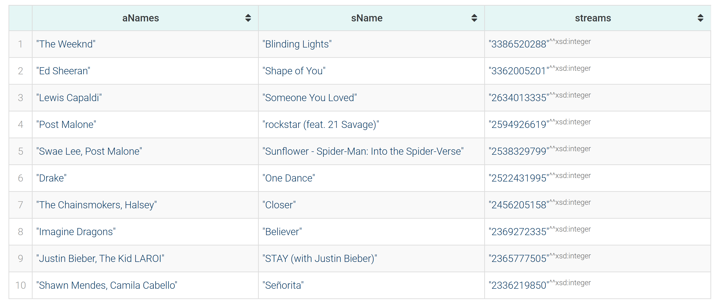
Query 1 - Top 10 songs by number of streams

Slide 5
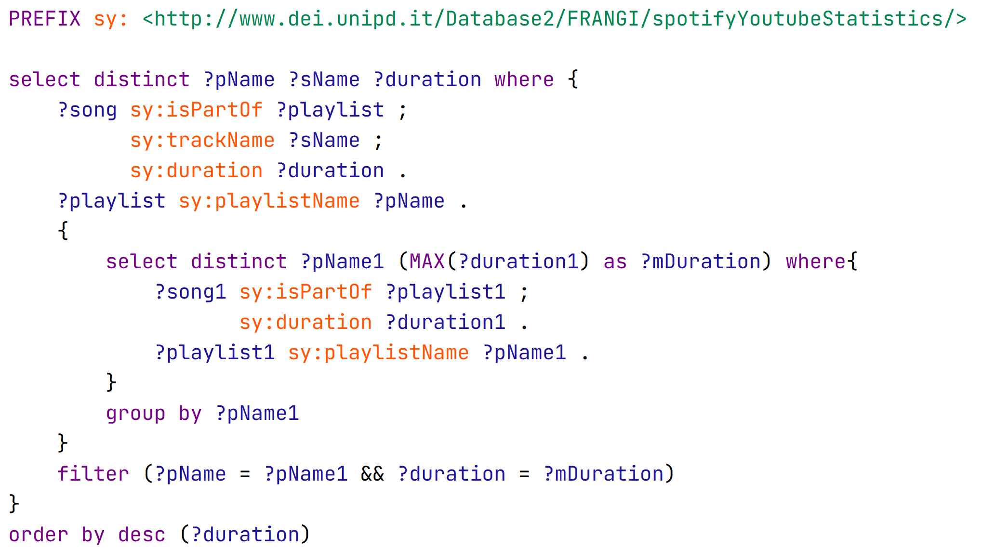
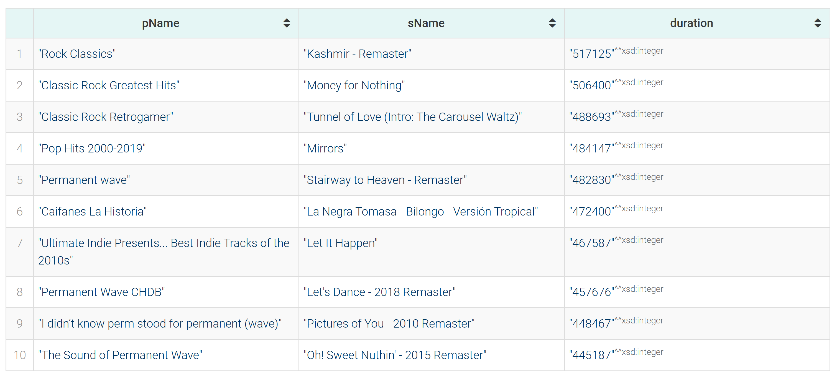
Query 2 - Song with max duration for each playlist, ordered by duration

Slide 6
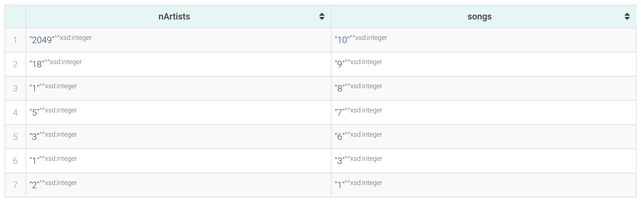
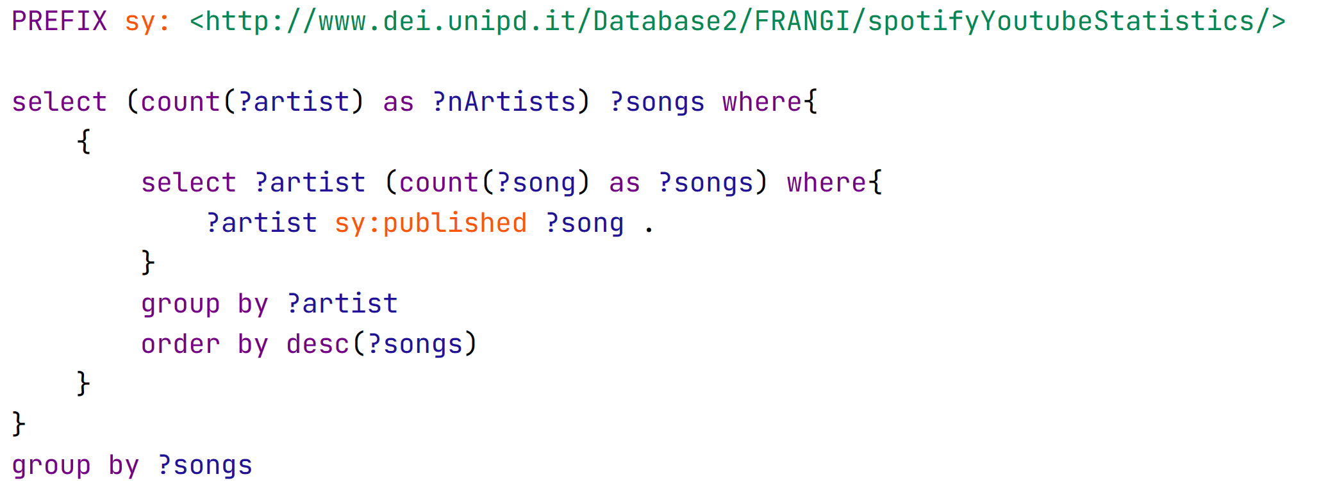
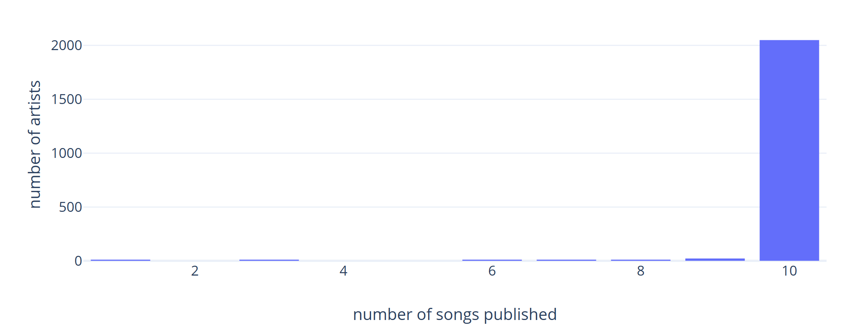
Query 3 - How many artists published n songs

Slide 7
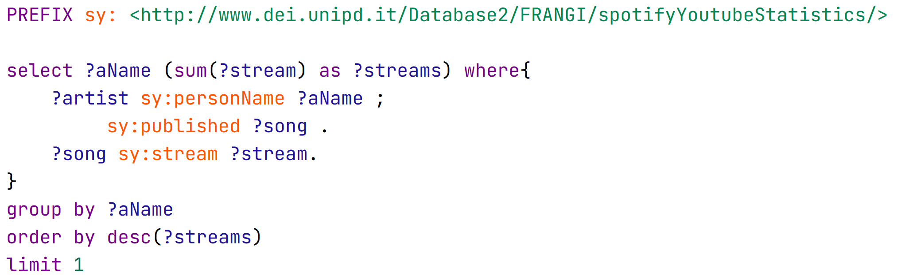

Query 4 - Artist that produced the most streams

Slide 8
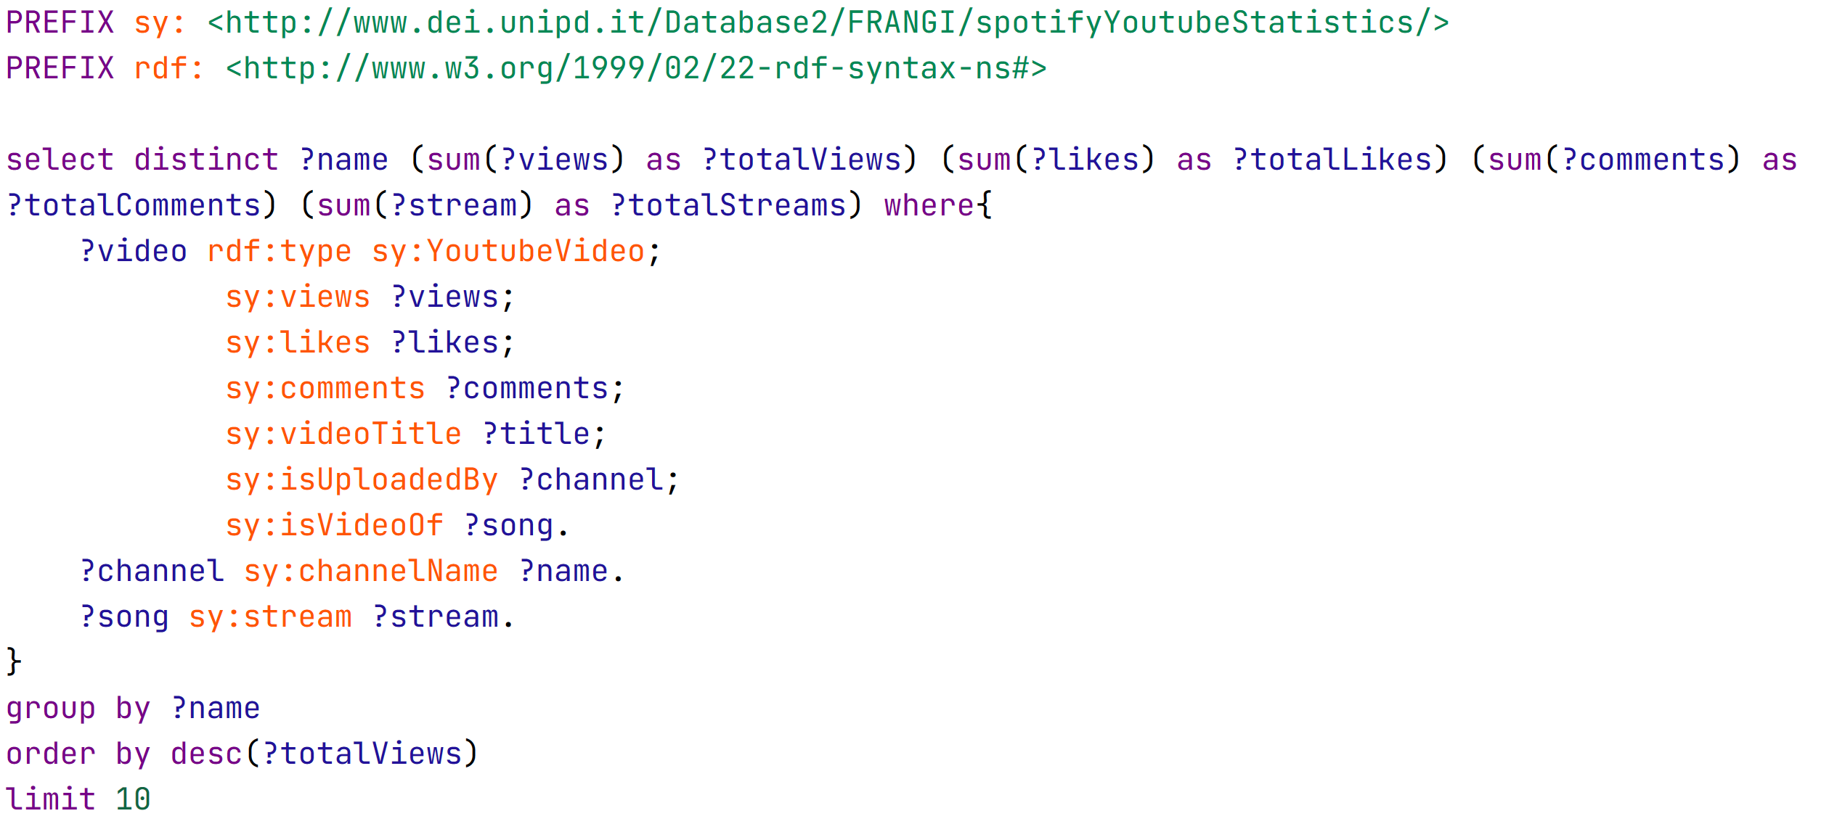
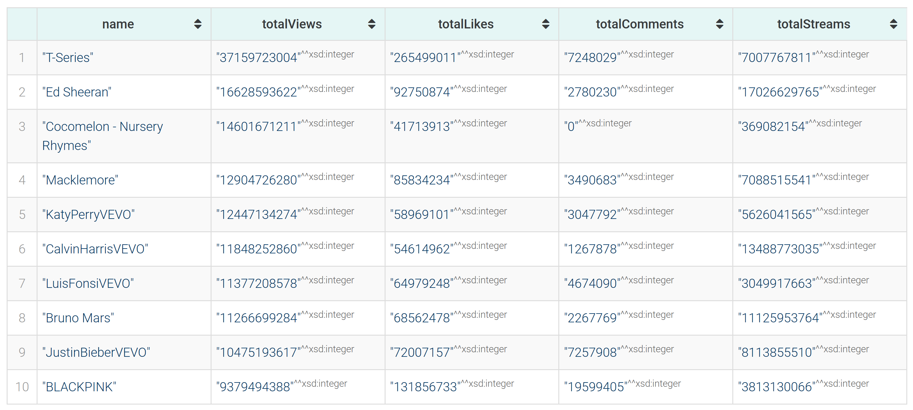
Query 5 - Top 10 channels by number of views, with also likes and comments

Slide 9
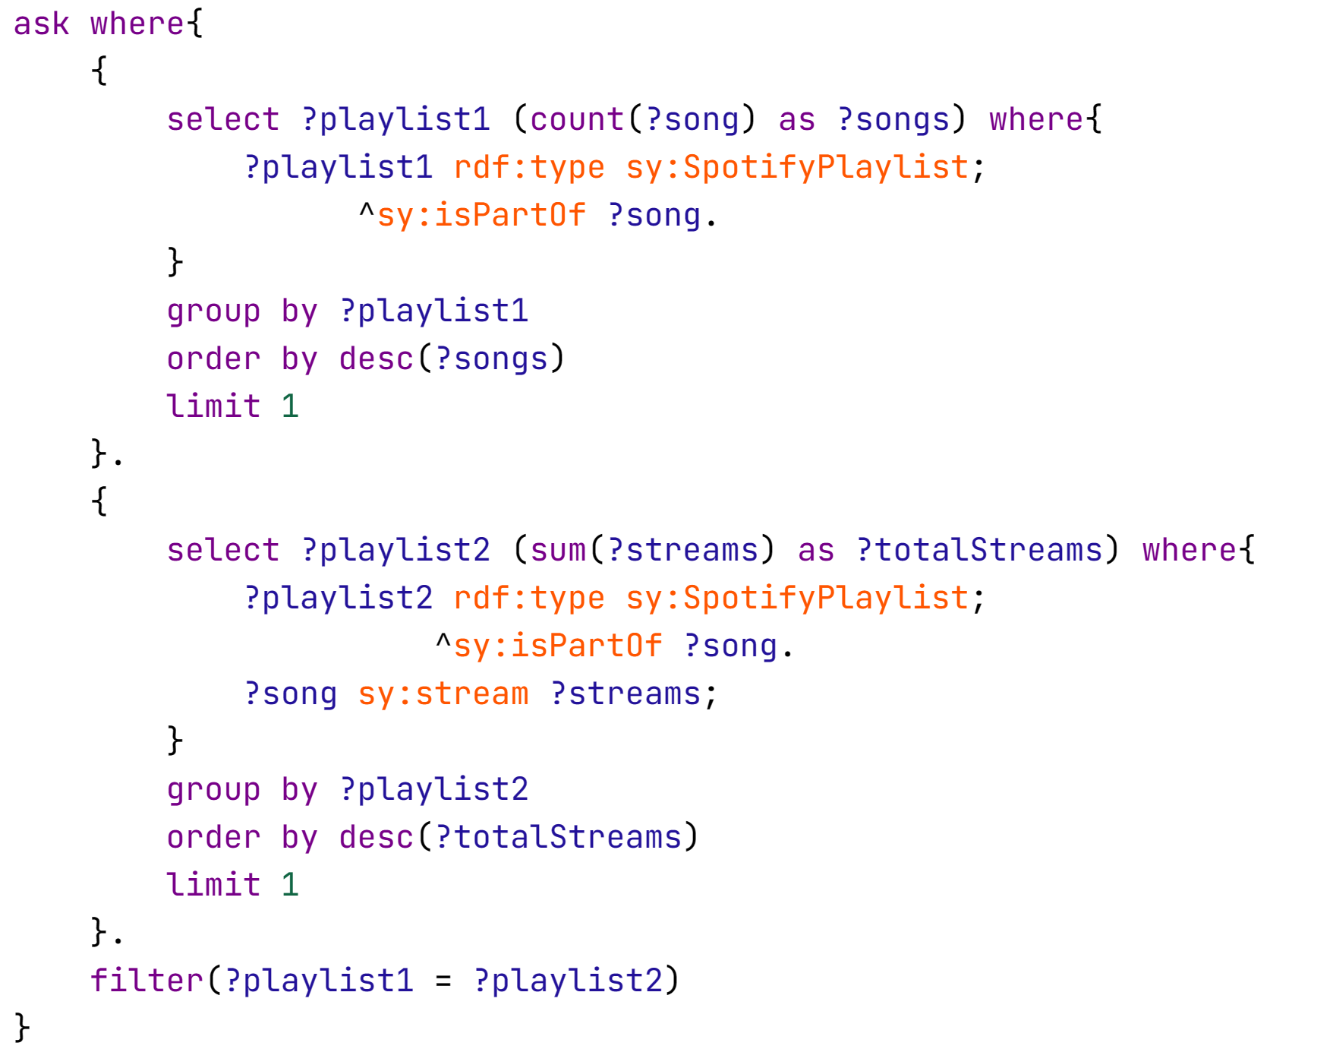

Query 6 - Is the playlist with most songs the one with most streams?

Slide 10
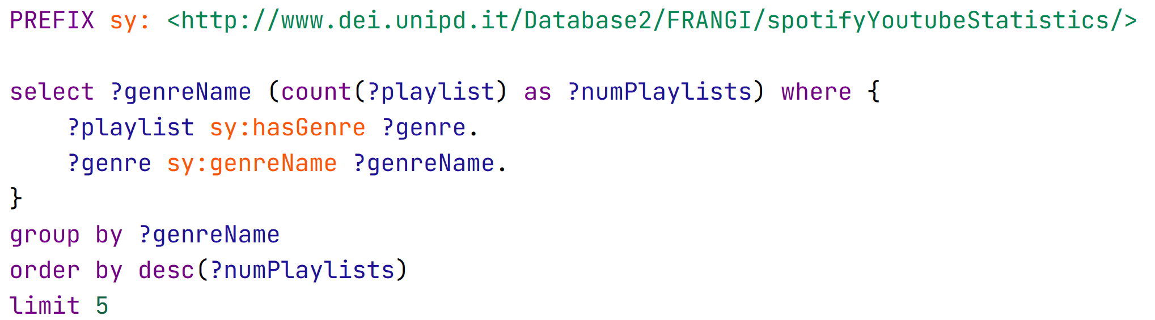
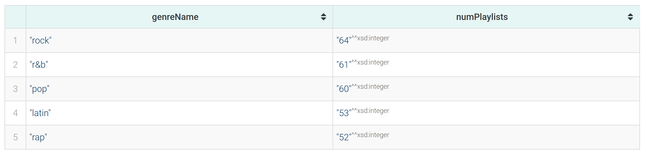
Query 7 - Most common 5 genres among playlists

Slide 11
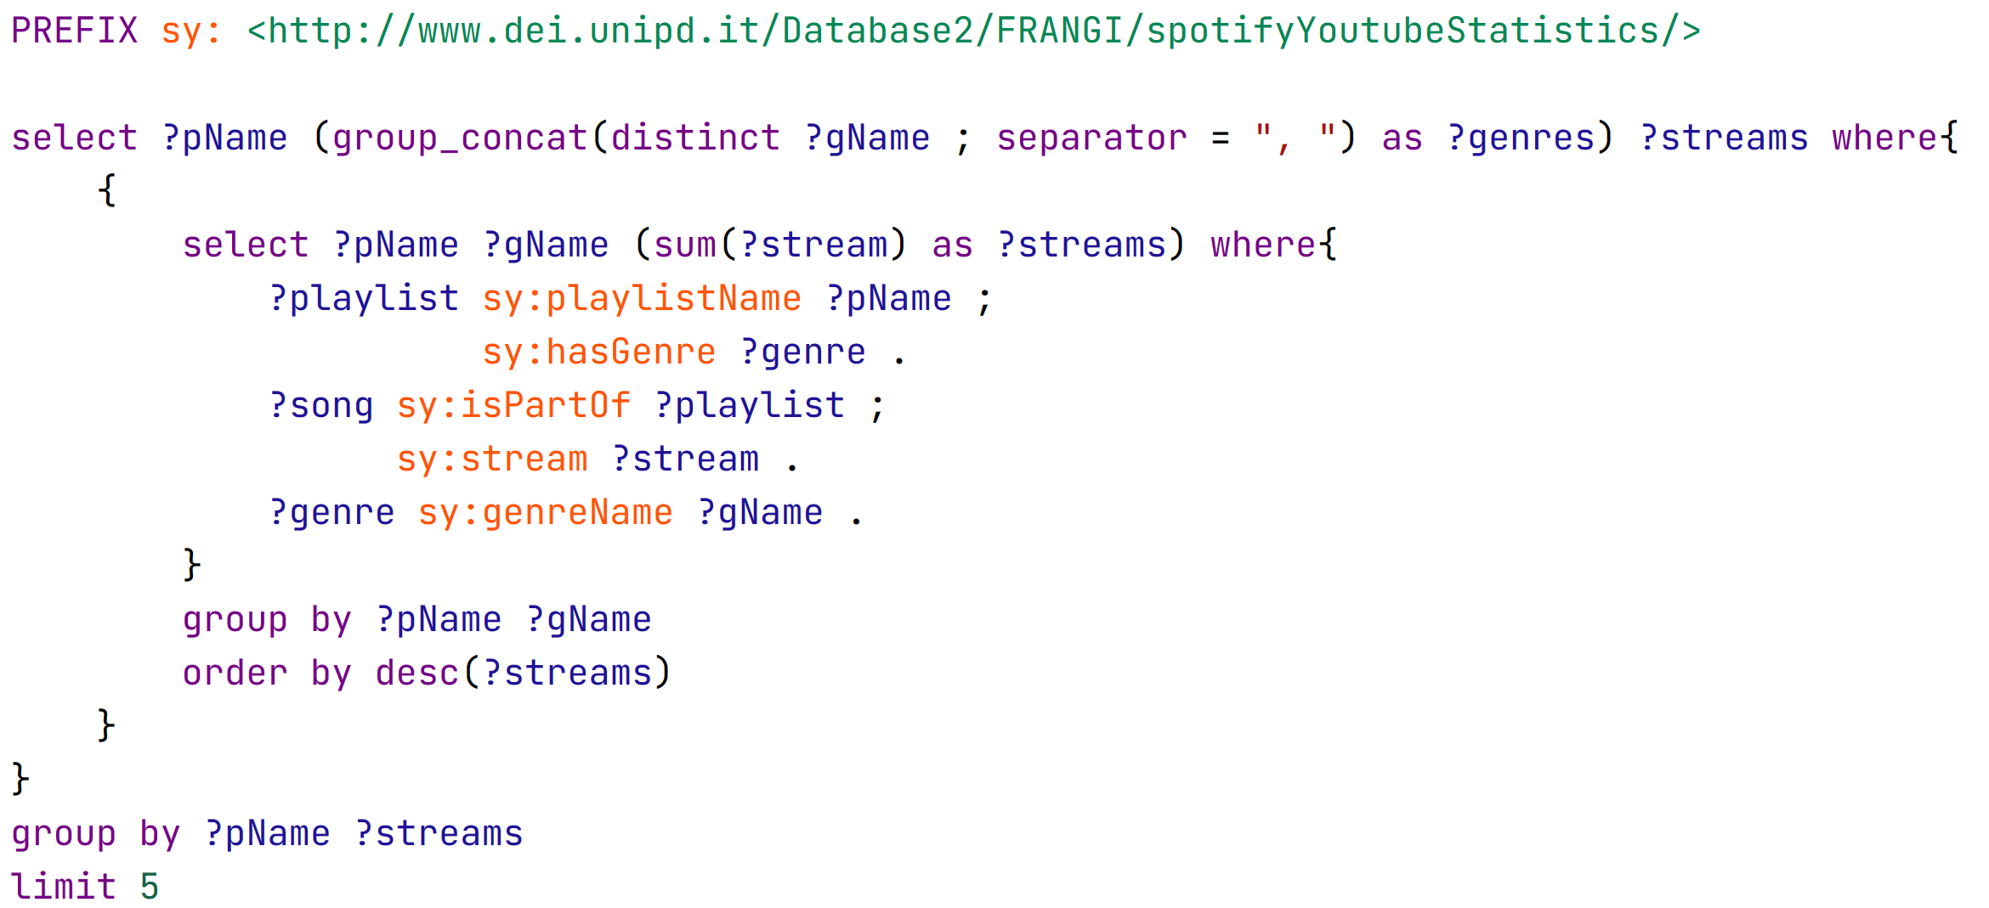
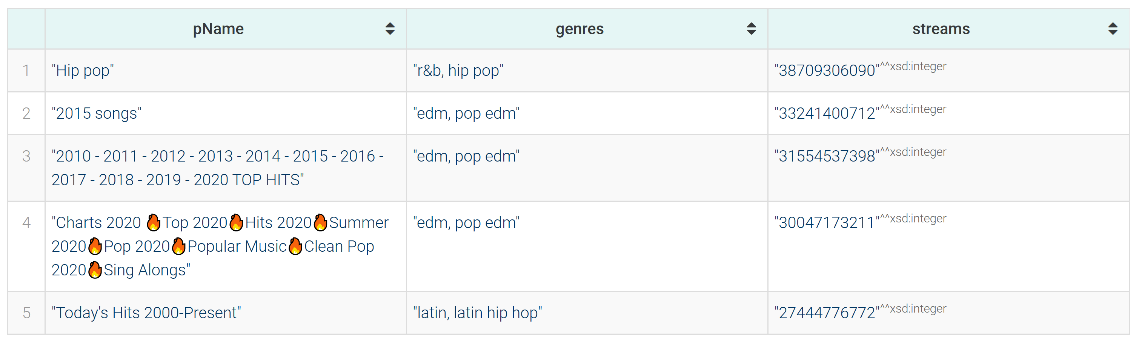
Query 8 - Genre of top 5 playlists with most played songs

Slide 12
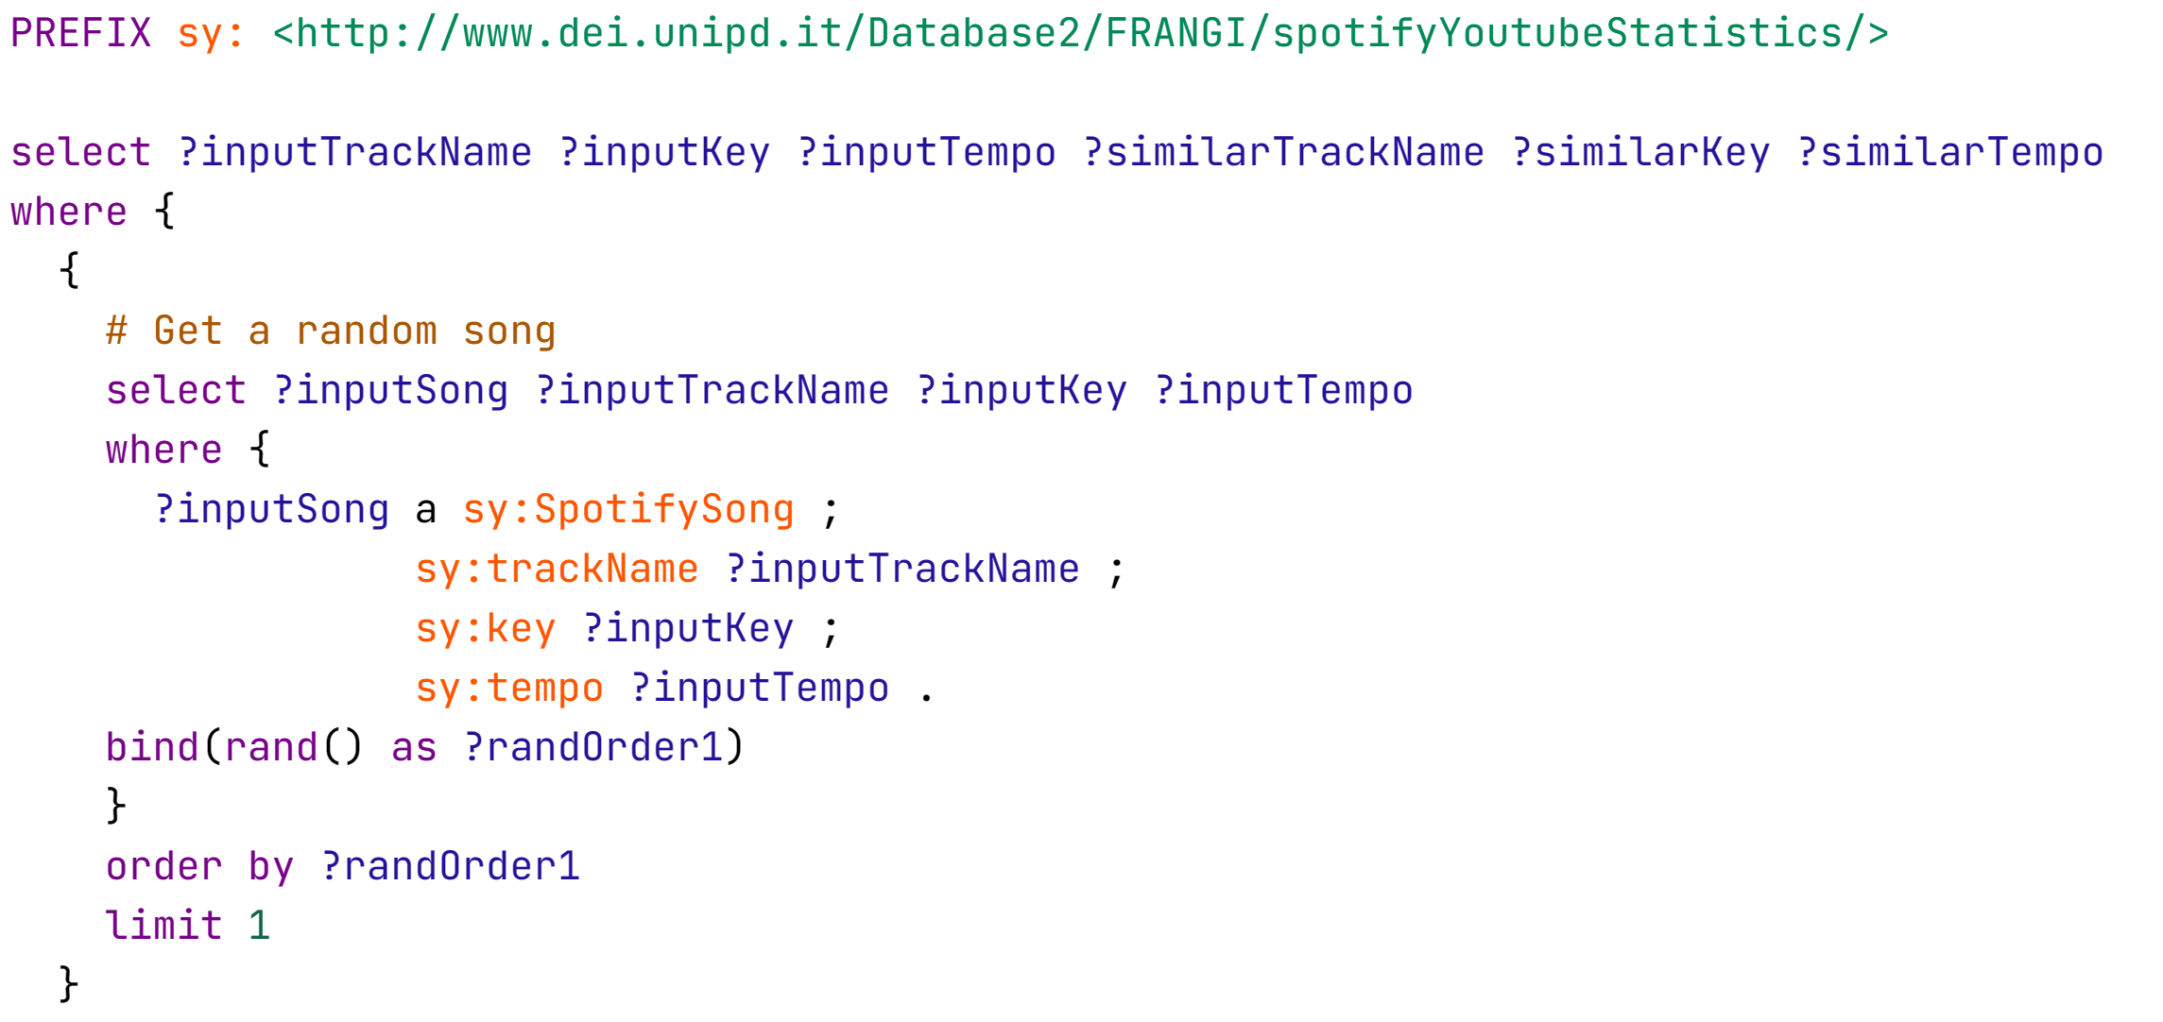
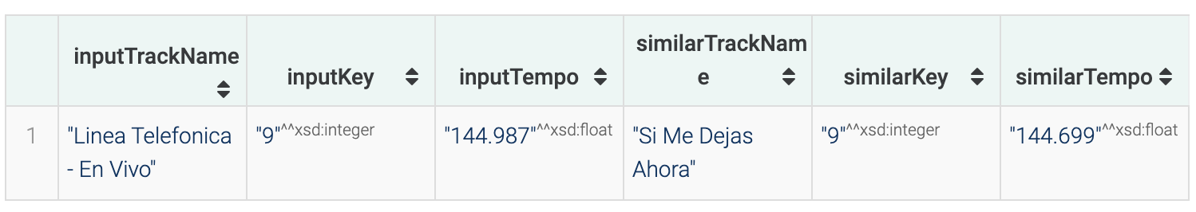
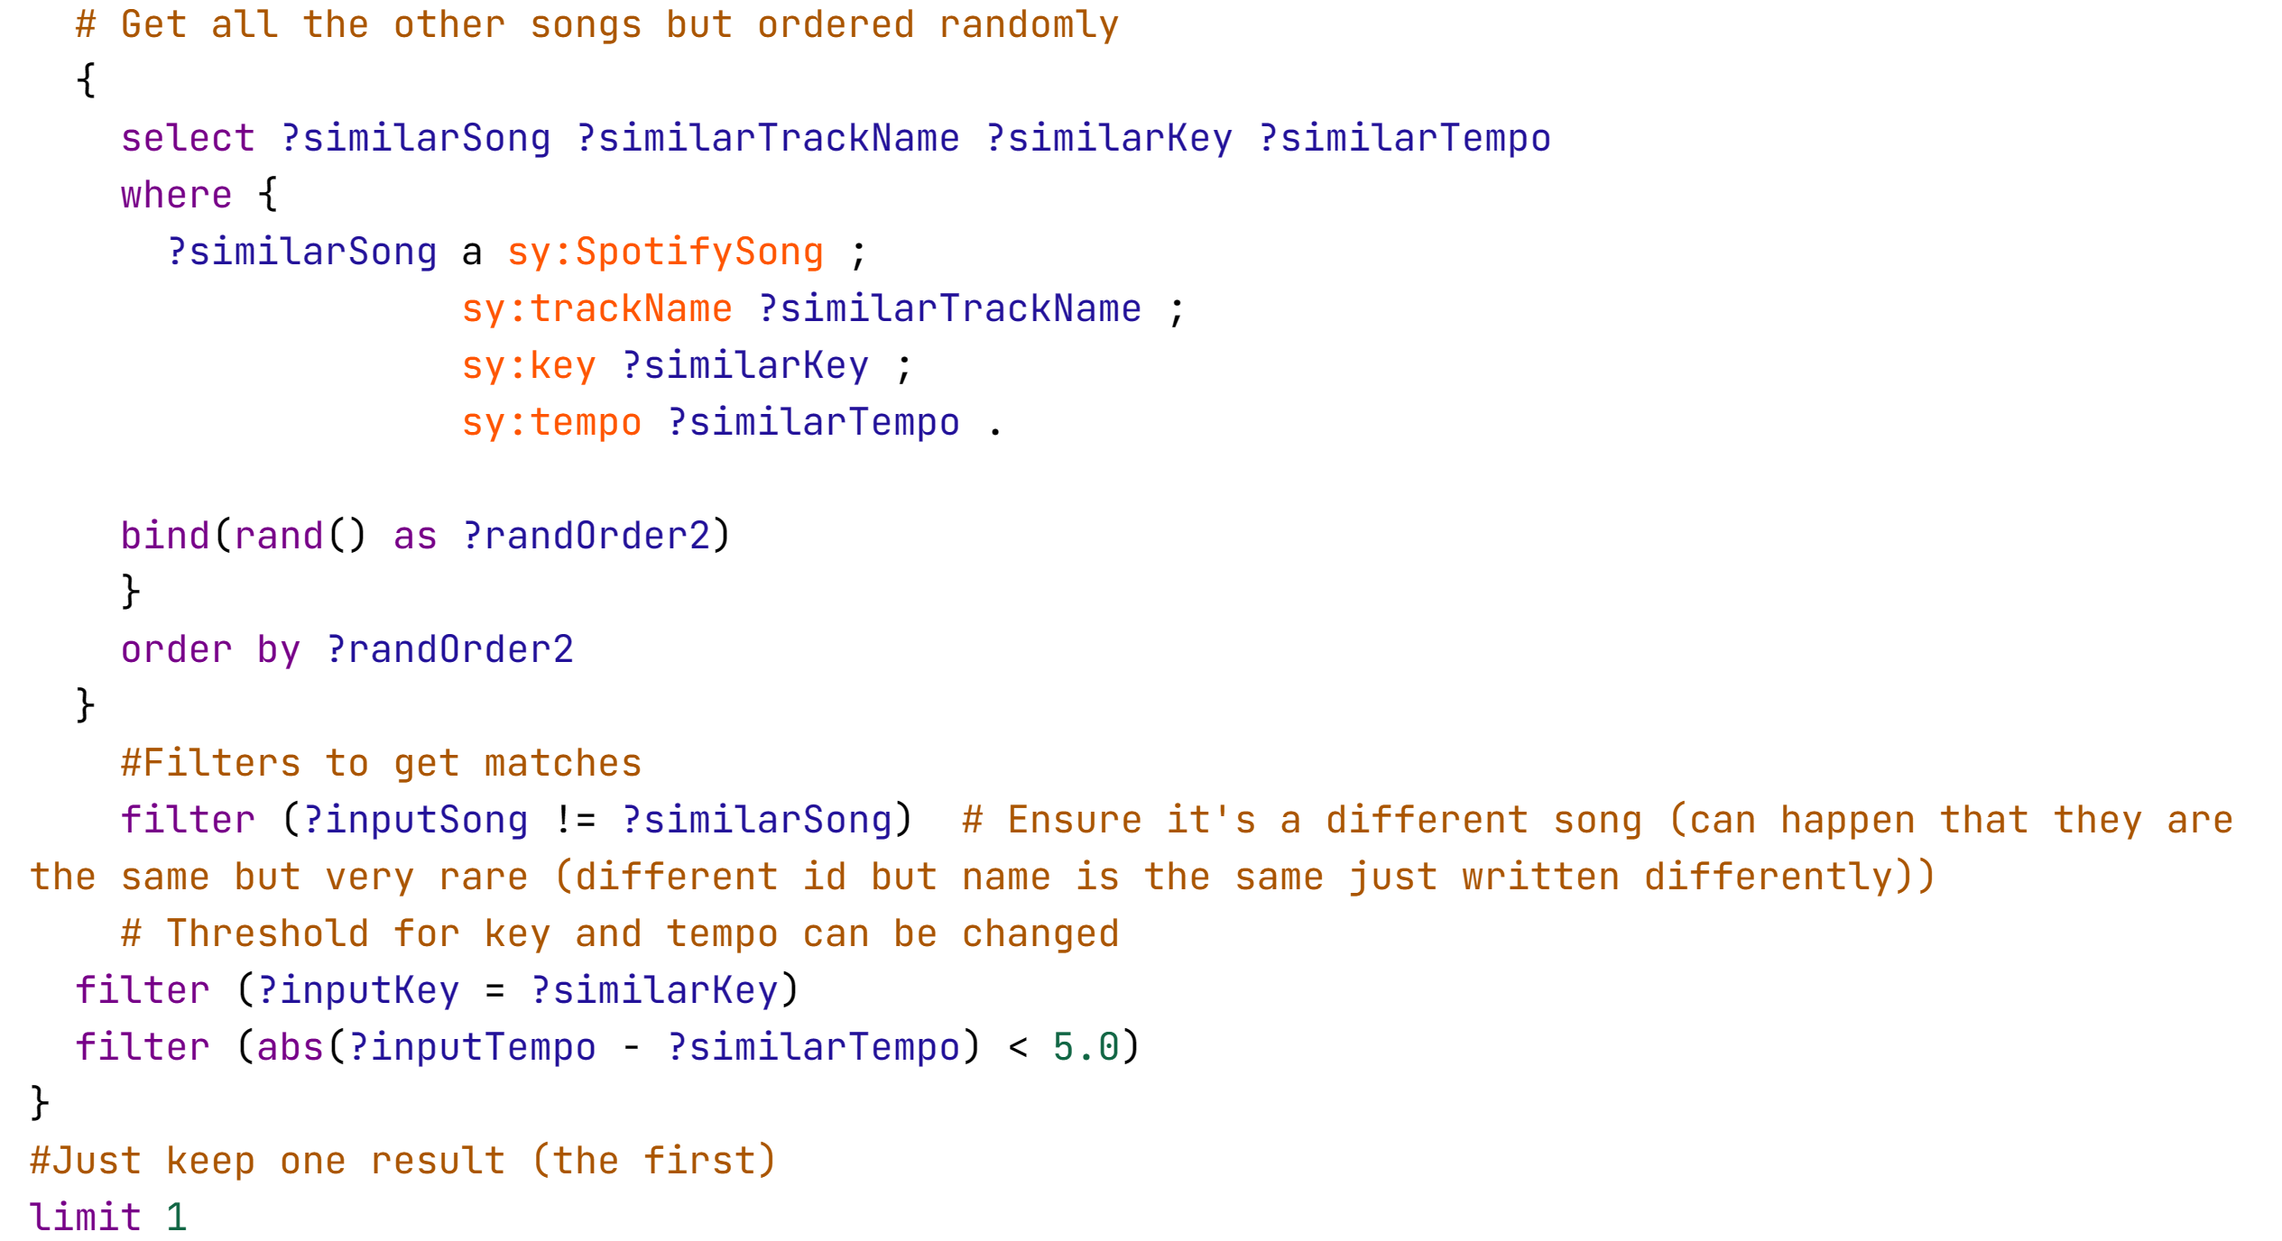
Query 9 - Random pair of songs that have similar tempo and key (useful for DJs)

Slide 13
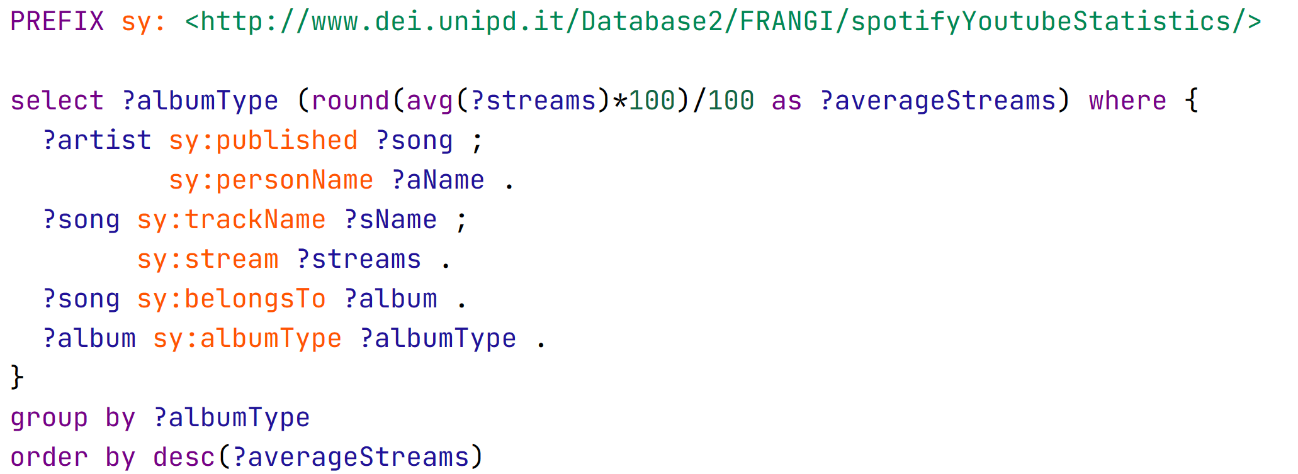
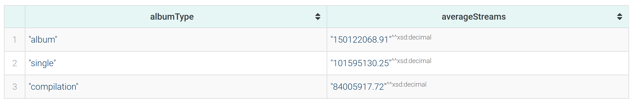
10 - Average number of views of songs for the 3 types of album types (single, compilation and album)

Slide 14
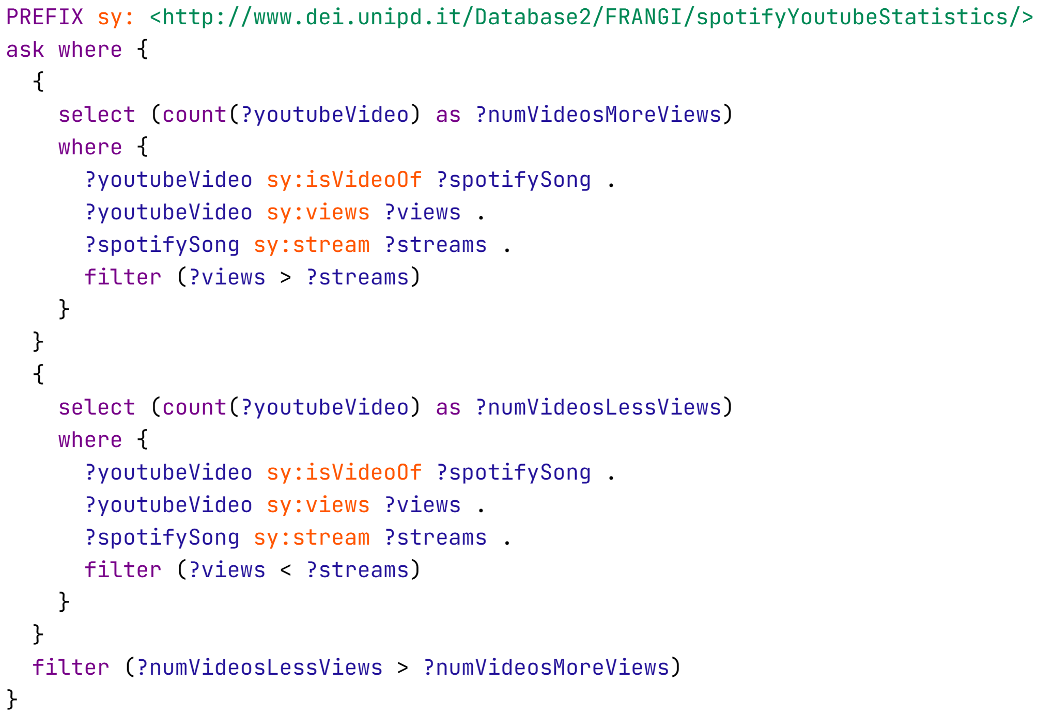

11 - Are number of streams of a song higher than the number of views of their related youtube video (in general)?

Slide 15
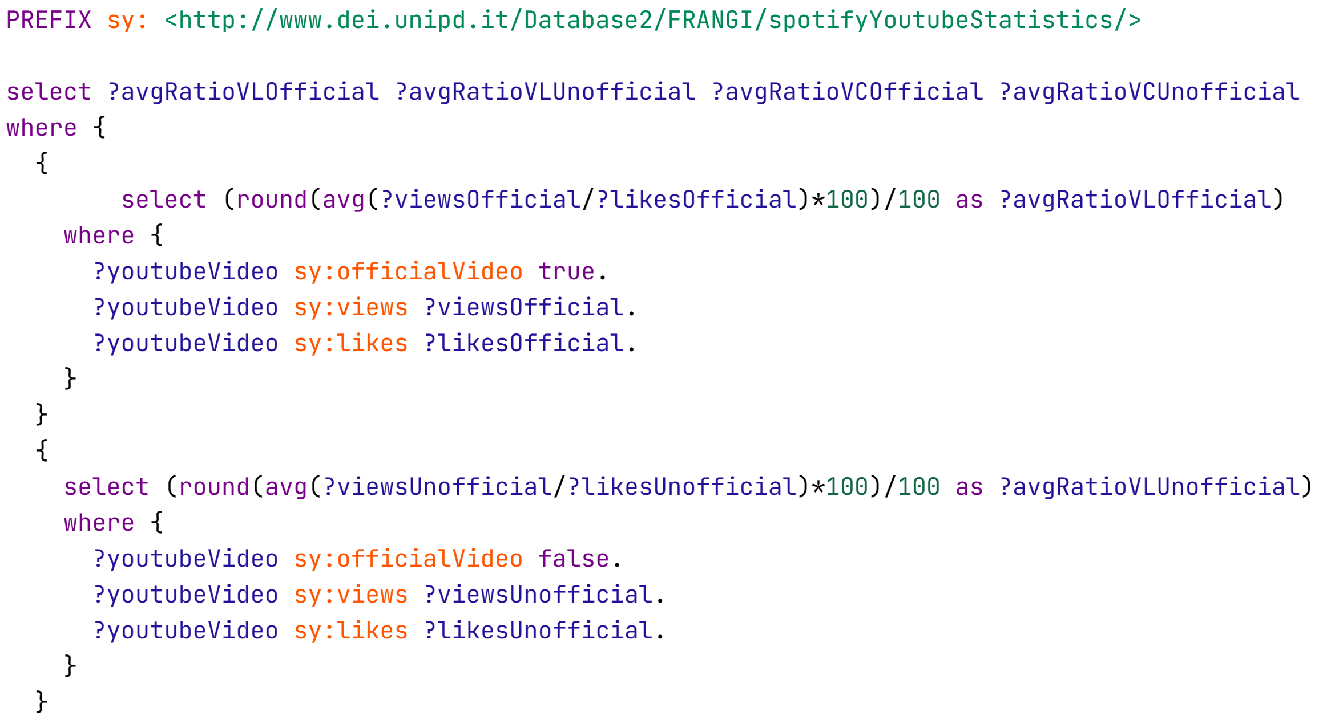

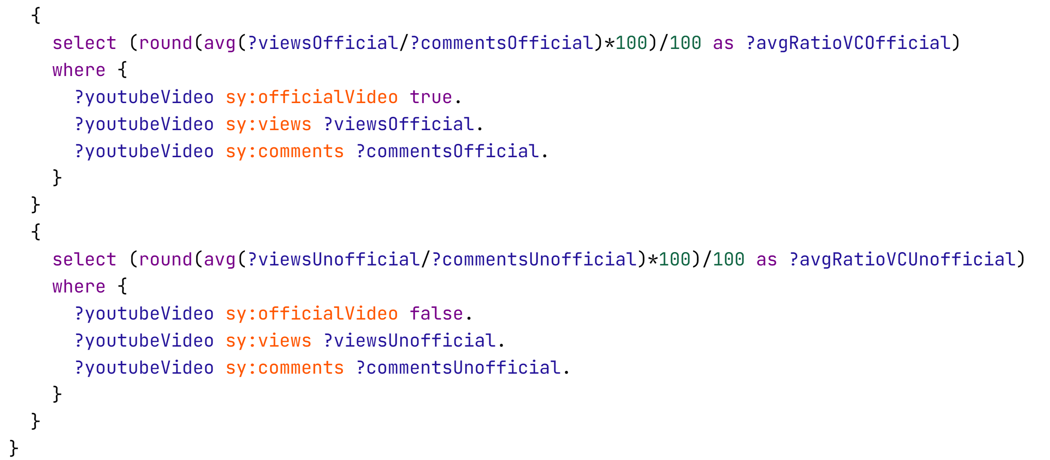
Query 12 - Average ratios of views/likes and views/comments of videos that are the official video of the songs and the ones that are not

Slide 16
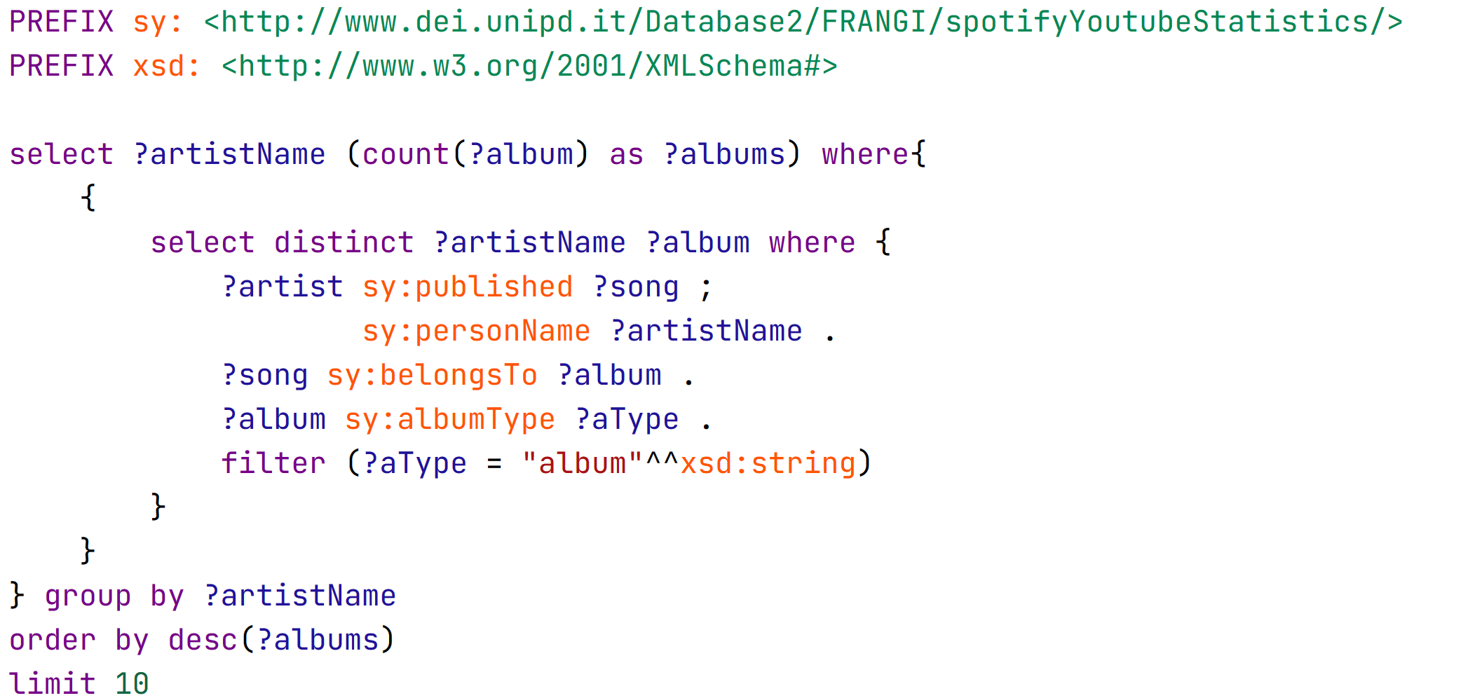
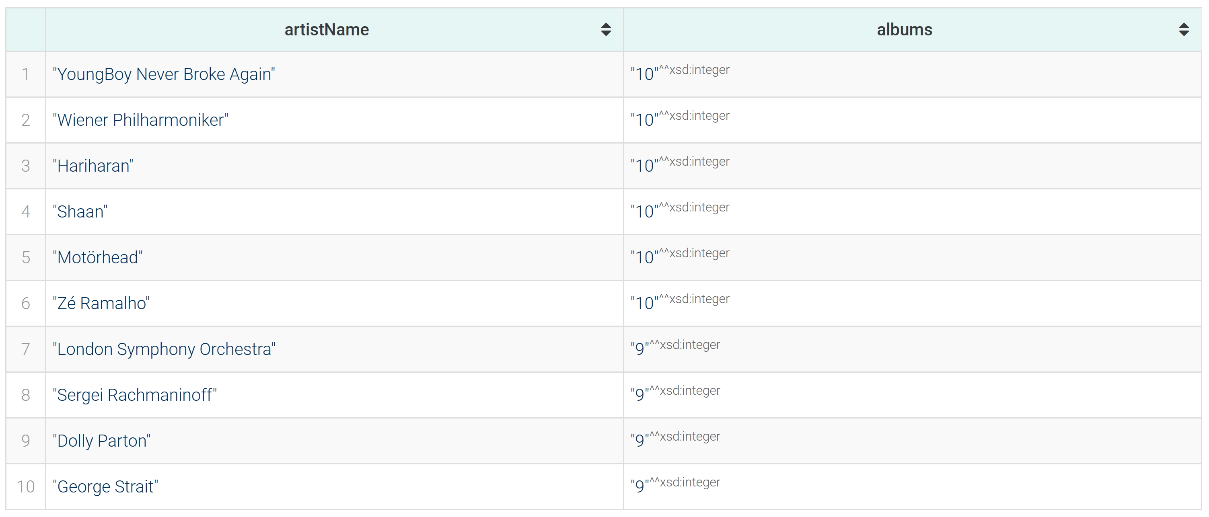
Query 13 - Top 10 artists by number of albums published

Slide 17
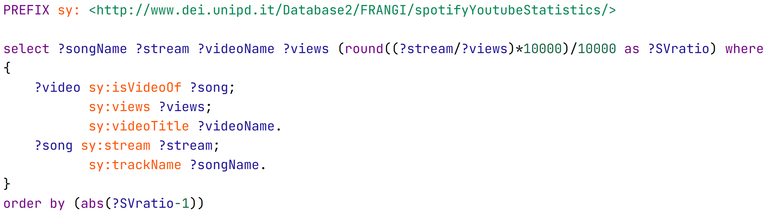
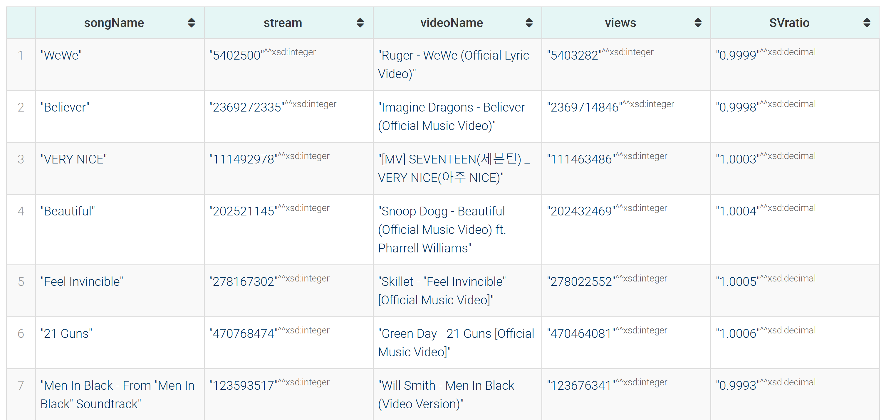
Query 14 - Relation between YouTube video views and corresponding song

Slide 18
Emergency center
Planets
Mercury
Jupiter
Venus
Saturn
It’s the closest planet to the Sun
It’s the biggest planet of them all
Venus has a beautiful name
Saturn was named after a Roman god

Slide 19
Emergency center
 | Despite being red, Mars is actually cold | Neptune is the farthest planet from the Sun | Saturn is a gas giant and has rings | Jupiter was named after a Roman god | Cost
Health plan A | Yes | No | No | No | $100 / month
Health plan B | Yes | Yes | No | No | $200 / month
Health plan C | Yes | Yes | Yes | Yes | $300 / month

Slide 20
Emergency center
Mars
Despite being red, Mars is actually a cold place. It’s full of iron oxide dust
Saturn
It has several rings and is composed mostly of hydrogen and helium
5,000
150K
+2.8%
+10.5%
Mars is cold
Venus is hot
Saturn has rings
Mercury is small

Slide 21
Emergency center
Jupiter
Jupiter doesn’t have a solid surface
Mars
The Solar System
Despite being red, Mars is very cold
Saturn
Saturn has a high number of moons

Slide 22
Emergency center
Earth
9am - 1pm
Earth has life and is the third planet from the Sun
Mon | Tue | Wed | Thu | Fri | Sat | Sun
01 | 02 | 03 | 04 | 05 | 06 | 07
08 | 09 | 10 | 11 | 12 | 13 | 14
15 | 16 | 17 | 18 | 19 | 20 | 21
22 | 23 | 24 | 25 | 26 | 27 | 28
29 | 30 | 31
Mars
6am - 9am
Despite being red, Mars is actually a really cold place
Pluto
9am - 6pm
Pluto is now considered a dwarf planet

Slide 23
Emergency center
Mars
Mercury
Jupiter
Earth
Venus
Service 1
Service 2
Service 3
Service 4
Service 1
Service 2
Service 3
Service 4
Service 1
Service 2
Service 3
Service 4
Service 1
Service 2
Service 3
Service 4
Service 1
Service 2
Service 3
Service 4

Slide 24
Emergency center
The Solar System
Mercury
Saturn
Jupiter
It’s the closest planet to the Sun
Saturn was named after a Roman god
Jupiter doesn’t have a solid surface
Mars
Earth
Mars is full of iron oxide dust
Earth is the planet with human life

Slide 25
Emergency center
01
Mars
It’s the red planet
It’s full of iron oxide dust
It’s a cold planet
02
Saturn
It was named after a god
It’s the ringed planet
It’s a gas giant
03
Mercury
It’s close to the Sun
It’s a small planet
It has craters and plains
04
Earth
It’s the planet with life
It’s where we all live
It harbors life

Slide 26
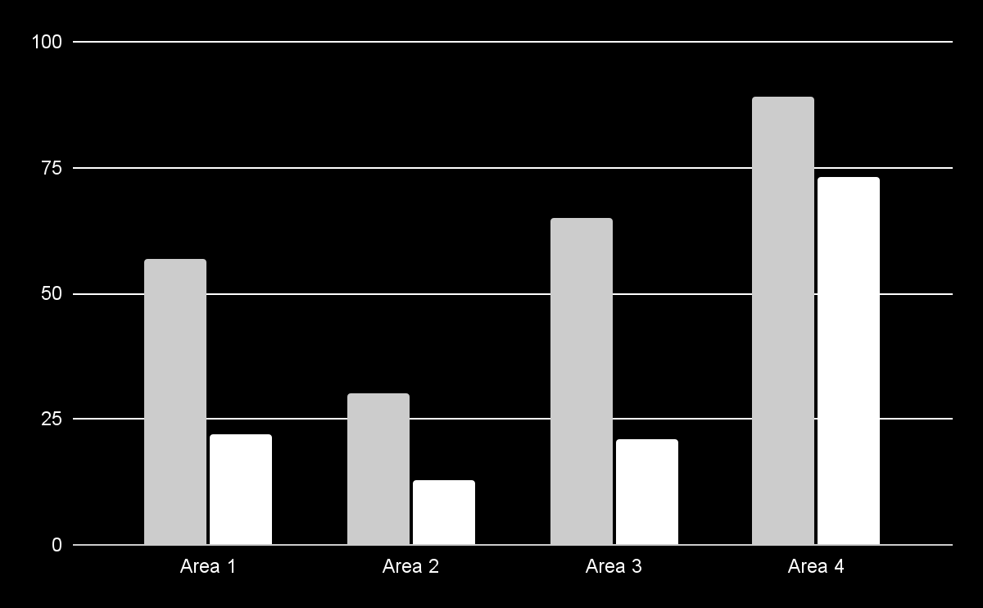
Emergency center
 | Venus | Mars
Area 1 | 57% | 22%
Area 2 | 30% | 13%
Area 3 | 65% | 21%
Area 4 | 89% | 73%
Follow the link in the graph to modify its data and then paste the new one here. For more info, click here

Slide 27
Emergency center
Services | Patient 1 | Patient 2 | Patient 3 | Patient 4
Mars | In treatment | Pending | Evaluated | Pending
Venus | Pending | In treatment | Pending | In treatment
Mercury | Evaluated | Pending | Pending | Pending
Jupiter | Pending | In treatment | Evaluated | In treatment
Saturn | In treatment | Evaluated | Evaluated | In treatment

Slide 28
Emergency center
Treatment
Recovery
01
Mercury is quite a small planet
25%
50%
75%
02
Saturn was named after a Roman god
Mars
Venus
Earth
03
Mars is a cold planet
Venus is very hot
We all live on Earth
Earth is the planet with human life

Slide 29
Emergency center
Despite being red, Mars is cold. It’s full of iron oxide dust
Step 1
Step 6
Earth is the third planet from the Sun and has life
Saturn is a gas giant and has several and beautiful rings
Step 2
Step 5
Venus has a beautiful name, but is an extremely hot planet
Neptune is the eighth planet from the Sun and is far from us
Step 3
Step 4
Mercury is the smallest planet in the entire Solar System

Slide 30
Emergency center
35%
Venus
Venus has extremely high temperatures
60%
Jupiter
Jupiter is the biggest planet of them all
15%
Saturn
Saturn is a gas giant and has several rings
85%
Earth
Earth is the planet on which we all live

Slide 31
Emergency center
Saturn
Saturn was named after a Roman god
Jupiter
Jupiter doesn’t have a solid surface
Mars
Despite being red, Mars is very cold

Slide 32
Emergency center
Mercury
It’s the closest planet to the Sun
Mars
Despite being red, Mars is very cold
Saturn
It’s a gas giant and has several rings
Jupiter
Jupiter was named after a Roman god

Slide 33
Emergency center
Tasks | Pending | In process | Finished
Mars was named after a god | X
Earth is the planet with life |  | X
Venus has high temperatures |  |  | X
Saturn has several rings |  | X
Neptune is far from the Sun |  |  | X
Jupiter is an enormous planet |  | X

Slide 34
Emergency center
Mercury
Jupiter
It’s the closest planet to the Sun
It’s the biggest planet of them all
Mars
Venus
Saturn
Neptune
Despite being red, Mars is actually a cold place
Venus is extremely hot, even more than Mercury
Saturn has a high number of moons, like Jupiter
Neptune is the eighth planet from the Sun

Slide 35
Emergency center
Mercury
01
04
Saturn
It’s the closest planet to the Sun
Saturn was named after a Roman god
Mars
02
05
Neptune
Mars is full of iron oxide dust
Neptune is very far from thE Sun
Venus
03
06
Earth
Venus has very high temperatures
Earth is also known as the Blue Planet

Slide 36

Emergency center
30%
70%
Venus
Neptune
Follow the link in the graph to modify its data and then paste the new one here. For more info, click here
Venus has very high temperatures
Neptune is very far from the Sun

Slide 37
Emergency center
50%
15%
75%
Mars
Earth
Jupiter
Mars is known as the red planet
Mars is full of iron oxide dust
Despite being red, it’s very cold
It was named after a god
Earth has life
Earth is the only planet that harbors life
It’s also known as the Blue Planet
Earth is where we all live on
It’s gas giant
It has around eighty moons
Jupiter is a really big planet
Jupiter is the biggest planet in the Solar System

Slide 38
Emergency center
Mars |  | Saturn
Despite being red, Mars is actually a cold place | Treatment | Saturn has a high number of moons, like Jupiter | Treatment
 | Mars is cold Venus is hot |  | Earth has life Saturn is big
Neptune |  | Venus
Neptune is the eighth planet from the Sun | Treatment | Venus has extremely high temperatures, more than Mercury | Treatment
 | Uranus is icy Jupiter is big |  | Pluto is small Neptune is far

Slide 39
Emergency center
Mercury
It’s the closest planet to the Sun
60%
40%
Saturn
Saturn was named after a Roman god
Mars
Venus
Despite being red, Mars is actually a cold place
Venus is extremely hot, even more than Mercury
Jupiter
Jupiter doesn’t have a solid surface

Slide 40
Emergency center
Mars | 10,000 | Despite being red, Mars is a really cold planet
Saturn | 528,000 | Saturn is a gas giant and has several and beautiful rings
Jupiter | 1 million | Jupiter is the biggest planet on the Solar System
Earth | 12,000 | Earth is the only planet that harbors human life
Venus | 80,000 | Venus is the second planet from the Sun

Slide 41
Emergency center
Earth
35%
Earth is the third planet from the Sun and the only one that harbors life
Jupiter
25%
Jupiter is a gas giant and the biggest planet in the Solar System
Saturn
40%
Saturn was named after a god and it has several and beautiful rings

Slide 42
Emergency center
Lucy Trey
Director
Sara Erins
Sam López
Erick Peters
Specialist
Specialist
Specialist
Eva Lara
Peter Doe
Allie Lucas
Jack Levi
Nurse
Nurse
Nurse
Nurse
Patient 1
Patient 2
Patient 1
Patient 2
Patient 1
Patient 2
Patient 1
Patient 2

Slide 43
Emergency center
01
02
03
04
Area
Area
Area
Area
Mars is full of iron oxide dust
Venus has a beautiful name
Earth is the planet on which we all live
Jupiter is an enormous planet
Despite being red, Mars is very cold
Venus has very high temperatures
Earth is also known as the Blue Planet
Jupiter doesn’t have a solid surface

Slide 44
Emergency center
Specialist | Mo | Tu | We | Th | Fr | Sa | Su | Total
Jenna Doe | 12h | 12h | 12h | - | - | 12h | - | 48h
Timmy Jimmy | - | - | - | - | 12h | - | 24h | 36h
Sarah Harris | 12h | - | - | 24h | - | - | 24h | 60h
Liam Dye | - | 12h | 12h | - | - | - | - | 24h
Tina Bramwell | 12h | - | 12h | - | 12h | - | 24h | 60h

Slide 45
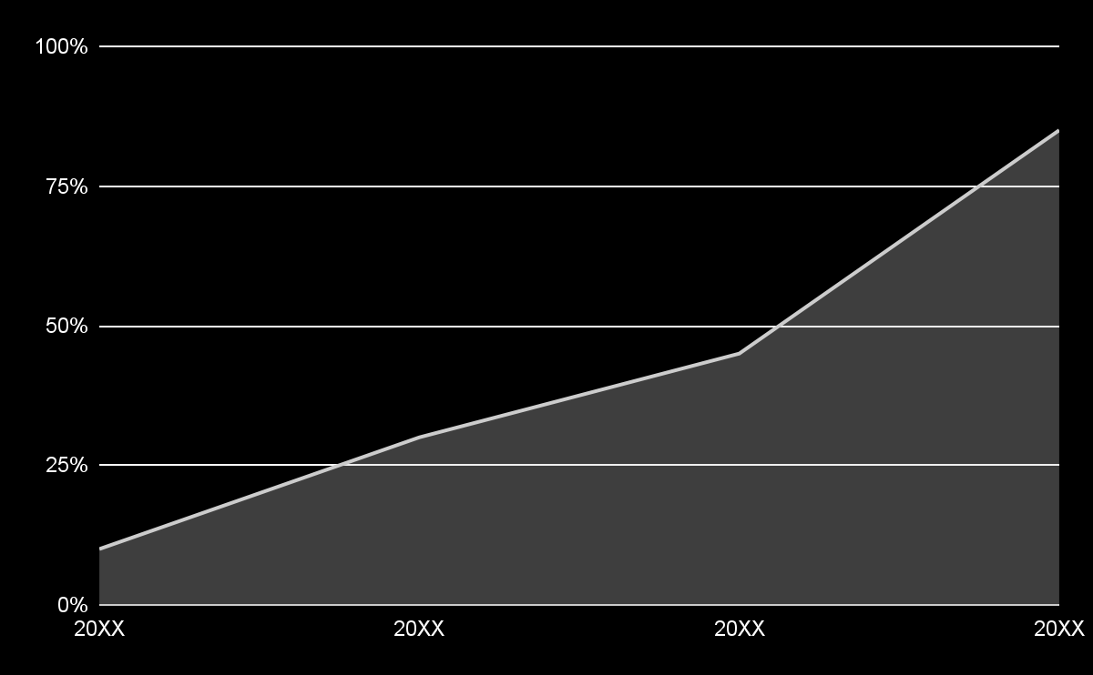
Emergency center
+75%
Improvement
From 20XX to 20XX
Despite being red, Mars is actually a cold place. It’s full of iron oxide dust, which gives the planet its reddish cast
Follow the link in the graph to modify its data and then paste the new one here. For more info, click here

Slide 46
Instructions for use
If you have a free account, in order to use this template, you must credit Slidesgo in your final presentation. Please refer to the next slide to read the instructions for premium users.
As a Free user, you are allowed to:
- Modify this template.
- Use it for both personal and commercial projects.
You are not allowed to:
- Sublicense, sell or rent any of Slidesgo Content (or a modified version of Slidesgo Content).
- Distribute Slidesgo Content unless it has been expressly authorized by Slidesgo.
- Include Slidesgo Content in an online or offline database or file.
- Offer Slidesgo templates (or modified versions of Slidesgo templates) for download.
- Acquire the copyright of Slidesgo Content.
For more information about editing slides, please read our FAQs or visit our blog:
https://slidesgo.com/faqs and https://slidesgo.com/slidesgo-school

Slide 47
Instructions for use (premium users)
As a Premium user, you can use this template without attributing Slidesgo.
You are allowed to:
Modify this template.
Use it for both personal and commercial purposes.
Share this template in an editable format with people who are not part of your team.
You are not allowed to:
Sublicense, sell or rent this Slidesgo Template (or a modified version of this Slidesgo Template).
Distribute this Slidesgo Template (or a modified version of this Slidesgo Template) or include it in a database or in any other product or service that offers downloadable images, icons or presentations that may be subject to distribution or resale.
Use any of the elements that are part of this Slidesgo Template in an isolated and separated way from this Template.
Register any of the elements that are part of this template as a trademark or logo, or register it as a work in an intellectual property registry or similar.
For more information about editing slides, please read our FAQs or visit our blog:
https://slidesgo.com/faqs and https://slidesgo.com/slidesgo-school

Slide 48
Infographics
You can add and edit some infographics to your presentation to present your data in a visual way.
Choose your favourite infographic and insert it in your presentation using Ctrl C + Ctrl V or Cmd C + Cmd V in Mac.
Select one of the parts and ungroup it by right-clicking and choosing “Ungroup”.
Change the color by clicking on the paint bucket.
Then resize the element by clicking and dragging one of the square-shaped points of its bounding box (the cursor should look like a double-headed arrow). Remember to hold Shift while dragging to keep the proportions.
Group the elements again by selecting them, right-clicking and choosing “Group”.
Repeat the steps above with the other parts and when you’re done editing, copy the end result and paste it into your presentation.
Remember to choose the “Keep source formatting” option so that it keeps the design. For more info, please visit our blog.

